Slide 1


AWS, CI/CD

Slide 2
Agenda
Introduction to cloud computing
Containers
Fundamentals of AWS
CI/CD in AWS
Deploying an application on AWS
Introduction to Devops -- CI/CD on cloud on AWS
CI/CD hands on lab
CI/CD with microservices deployed on ECS/EKS

Slide 3
Introduction to cloud computing
Cloud Introduction,
Difference between on-premise server and cloud offerings - Server, Storage, Service, PAAS, SAAS. IAAS,
Private cloud,
Public cloud

Slide 4
What is AWS?
AWS stands for Amazon Web Services.
The AWS service is provided by the Amazon that uses distributed IT infrastructure to provide different IT resources available on demand
It provides different services such as infrastructure as a service (IaaS), platform as a service (PaaS) and packaged software as a service (SaaS).
Amazon Web Services (AWS) is Amazon’s cloud web hosting platform that offers flexible, reliable, scalable, easy-to-use, and cost-effective solutions
Amazon launched AWS, a cloud computing platform to allow the different organizations to take advantage of reliable IT infrastructure.

Slide 5
What is Cloud Computing?
Cloud computing is an internet-based computing service in which large groups of remote servers are networked to allow centralized data storage, and online access to computer services or resources.
Using cloud computing, organizations can use shared computing and storage resources rather than building, operating, and improving infrastructure on their own.

Slide 6
Cloud computing is a model that enables the following features.
Users can provision and release resources on-demand.
Resources can be scaled up or down automatically, depending on the load.
Resources are accessible over a network with proper security.
Cloud service providers can enable a pay-as-you-go model, where customers are charged based on the type of resources and per usage.

Slide 7
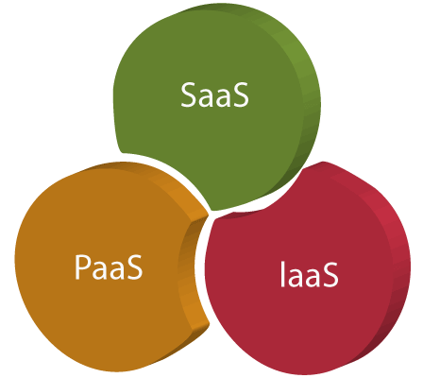
Cloud Service Models

Slide 8
Infrastructure as a Service (IaaS)
IaaS is also known as Hardware as a Service (HaaS).
It is a computing infrastructure managed over the internet.
The main advantage of using IaaS is that it helps users to avoid the cost and complexity of purchasing and managing the physical servers.
Example: DigitalOcean, Linode, Amazon Web Services (AWS), Microsoft Azure, Google Compute Engine (GCE), Rackspace, and Cisco Metacloud.

Slide 9
Platform as a Service (PaaS)
PaaS cloud computing platform is created for the programmer to develop, test, run, and manage the applications
.
Here, the service provider provides various services like databases, queues, workflow engines, e-mails, etc. to their customers.
The customer can then use these components for building their own applications.
The services, availability of resources and data backup are handled by the service provider that helps the customers to focus more on their application's functionality.
Example: AWS Elastic Beanstalk, Windows Azure, Heroku, Force.com, Google App Engine, Apache Stratos, Magento Commerce Cloud, and OpenShift.

Slide 10
Software as a Service (SaaS)
It is a software in which the applications are hosted by a cloud service provider. Users can access these applications with the help of internet connection and web browser.
. As the name suggests, here the third-party providers provide end-user applications to their customers with some administrative capability at the application level, such as the ability to create and manage their users.
Also some level of customizability is possible such as the customers can use their own corporate logos, colors, etc.
Example: BigCommerce, Google Apps, Salesforce, Dropbox, ZenDesk, Cisco WebEx, ZenDesk, Slack, and GoToMeeting.

Slide 11
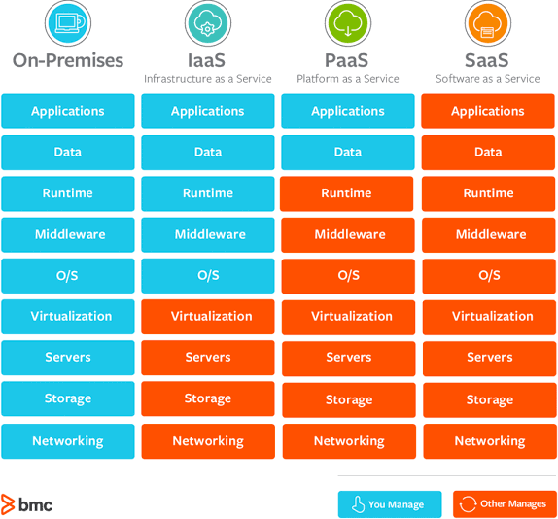

Slide 12
Types of Clouds
Public Cloud:In public cloud, the third-party service providers make resources and services available to their customers via Internet. Customer’s data and related security is with the service providers’ owned infrastructure.
Private Cloud:A private cloud also provides almost similar features as public cloud, but the data and services are managed by the organization or by the third party only for the customer’s organization. In this type of cloud, major control is over the infrastructure so security related issues are minimized.
Hybrid Cloud:A hybrid cloud is the combination of both private and public cloud. The decision to run on private or public cloud usually depends on various parameters like sensitivity of data and applications, industry certifications and required standards, regulations, etc.

Slide 13
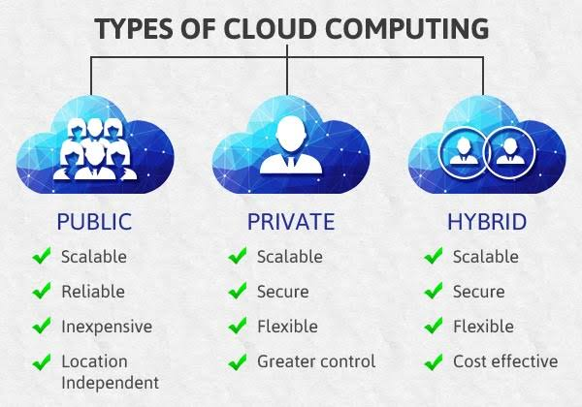

Slide 14
Containers
Introduction to Container
Containers vs VM

Slide 15
containers
A container is a standard unit of software that packages up code and all its dependencies so the application runs quickly and reliably from one computing environment to another.
Containers are a form of operating system virtualization. A single container might be used to run anything from a small microservice or software process to a larger application.
Inside a container are all the necessary executables, binary code, libraries, and configuration files.
Compared to server or machine virtualization approaches, however, containers do not contain operating system images. This makes them more lightweight and portable, with significantly less overhead.
In larger application deployments, multiple containers may be deployed as one or more container clusters.
Such clusters might be managed by a container orchestrator such as Kubernetes.

Slide 16
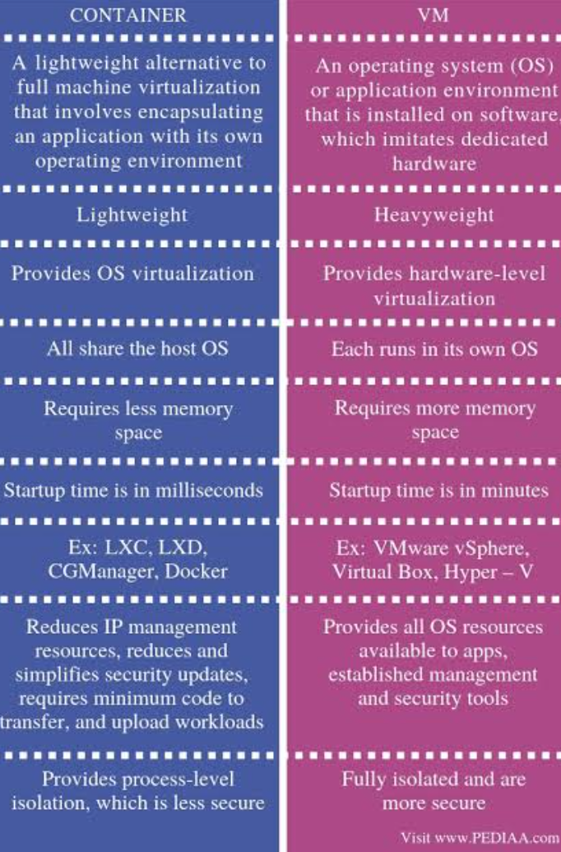

Slide 17
Fundamentals of AWS
Global cloud infrastructure of AWS (Regions, AZ),
Cloud services -- Compute, Storage, Database, Container

Slide 18
AWS Global Infrastructure
Global infrastructure is a region around the world in which AWS is based.
Global infrastructure is a bunch of high-level IT services which is shown below:
AWS is available in 19 regions, and 57 availability zones in December 2018 and 5 more regions 15 more availability zones for 2019.

Slide 19
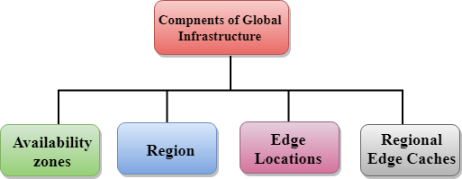
components that make up the AWS infrastructure:

Slide 20
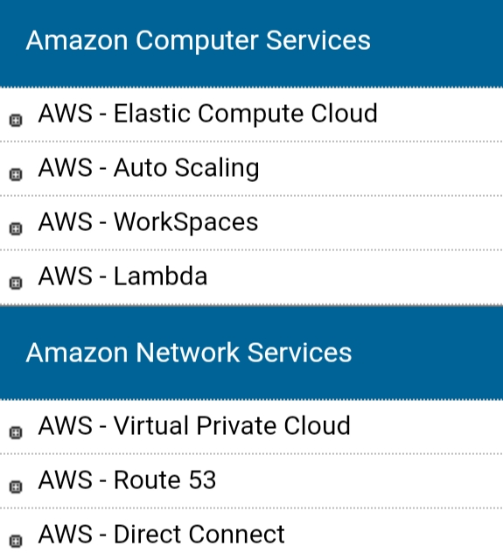
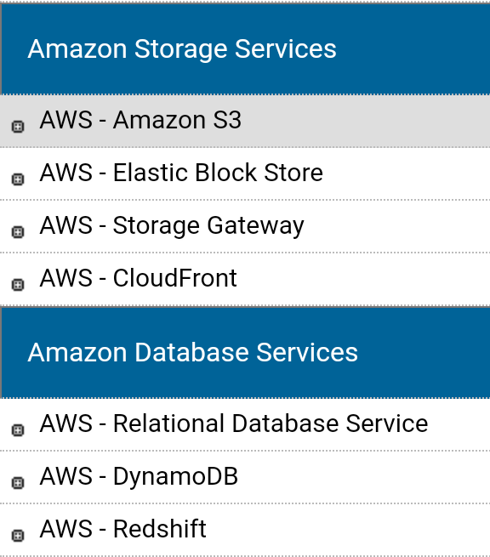
Cloud services -- Compute, Storage, Database, Container

Slide 21
Compute Fundamentals for AWS
EC2 – Amazon Elastic Compute Cloud
ECS – Amazon Elastic Container Service
ECR – Amazon Elastic Container Registry
EKS – Amazon Elastic Container Service for Kubernetes
AWS Elastic Beanstalk
AWS Lambda
AWS Batch
Amazon Lightsail

Slide 22
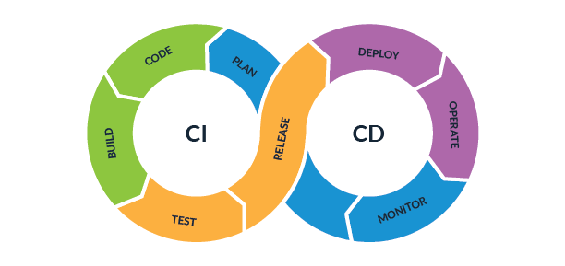
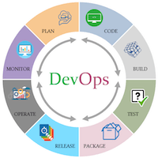
CI/CD in AWS
Introducing devops (CI/CD) on AWS

Slide 23
DevOps
The DevOps is the combination of two words, one is Development and other is Operations.
It is a culture to promote the development and operation process collectively.
This allows a single team to handle the entire application lifecycle, from development to testing, deployment, and operations.
DevOps helps you to reduce the disconnection between software developers, quality assurance (QA) engineers, and system administrators.
DevOps tools such as Git, Ansible, Docker, Puppet, Jenkins, Chef, Nagios, and Kubernetes.

Slide 24
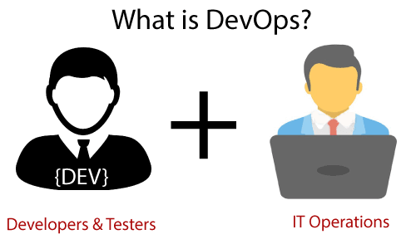
DevOps promotes collaboration between Development and Operations team to deploy code to production faster in an automated & repeatable way.
DevOps is nothing but a practice or methodology of making "Developers" and "Operations" folks work together. DevOps represents a change in the IT culture with a complete focus on rapid IT service delivery through the adoption of agile practices in the context of a system-oriented approach

Slide 25
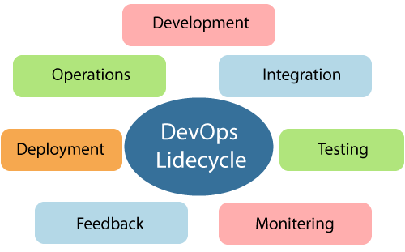
DevOps Lifecycle

Slide 26
1) Continuous Development
This phase involves the planning and coding of the software.
The vision of the project is decided during the planning phase.
And the developers begin developing the code for the application.
There are no DevOps tools that are required for planning, but there are several tools for maintaining the code.

Slide 27
2) Continuous Integration
This stage is the heart of the entire DevOps lifecycle.
It is a software development practice in which the developers require to commit changes to the source code more frequently.
This may be on a daily or weekly basis. Then every commit is built, and this allows early detection of problems if they are present.
Building code is not only involved compilation, but it also includes unit testing, integration testing, code review, and packaging.

Slide 28
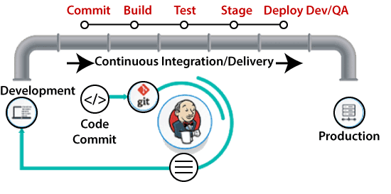
The code supporting new functionality is continuously integrated with the existing code.
Therefore, there is continuous development of software. The updated code needs to be integrated continuously and smoothly with the systems to reflect changes to the end-users.

Slide 29
DevOps Pipeline
A pipeline in software engineering team is a set of automated processes which allows DevOps professionals and developer to reliably and efficiently compile, build, and deploy their code to their production compute platforms.
The most common components of a pipeline in DevOps are build automation or continuous integration, test automation, and deployment automation.
Continuous Integration Pipeline
Continuous Delivery Pipeline

Slide 30
Deploying an application on AWS
Learn how to automate a web application deployment using Services like Elastic Beanstalk.
Create environment in AWS containing VPC, ELB, EC2 Instances, Subnets, Security groups …for deploying different web applications

Slide 31
AWS DevOps
AWS is the best cloud service provider, and DevOps is the implementation of the software development lifecycle.
Here are some reasons which make AWS DevOps a highly popular combination, such as:
AWS CloudFormation
AWS EC2
AWS CloudWatch
AWS CodePipeline

Slide 32
CI/CD hands on lab
CI/CD with AWS Code services.

Slide 33
CI/CD with microservices deployed on ECS/EKS
Setup Codepipeline within the AWS environment that will automate the build & deployment of microservices containers on ECS / EKS. Developers will write / enhance microservices & commit it to the source control repository. They will then watch how the CI/CD is automatically executed without downtime to the existing service TASKS:
1. Setting up code repository for microservices
2. Infrastructure automation setup
3. Infrastructure creation using automation scripts
4. Use the CI/CD infrastructure & check automated build, deploy of artifacts on the container instances. Eg for ECS, the build should create a container image of a microservice & push it to the ECR repository, The deploy should deploy the container images on the ECS cluster having a task definition, Service, Target group
5. The above process should be repeated so that any changes to the source code will result in the containers being automatically updated to reflect the new change

Slide 34
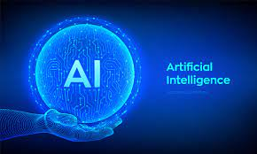
Artificial Intelligence

Slide 35
What is Artificial Intelligence?
According to the father of Artificial Intelligence, John McCarthy, it is “The science and engineering of making intelligent machines, especially intelligent computer programs”.
Artificial Intelligence is a way of making a computer, a computer-controlled robot, or a software think intelligently, in the similar manner the intelligent humans think.
AI is accomplished by studying how human brain thinks, and how humans learn, decide, and work while trying to solve a problem, and then using the outcomes of this study as a basis of developing intelligent software and systems.

Slide 36
Goals of AI
To Create Expert Systems − The systems which exhibit intelligent behavior, learn, demonstrate, explain, and advice its users.
To Implement Human Intelligence in Machines − Creating systems that understand, think, learn, and behave like humans.

Slide 37
What Contributes to AI?
Artificial intelligence is a science and technology based on disciplines such as Computer Science, Biology, Psychology, Linguistics, Mathematics, and Engineering.
A major thrust of AI is in the development of computer functions associated with human intelligence, such as reasoning, learning, and problem solving.

Slide 38
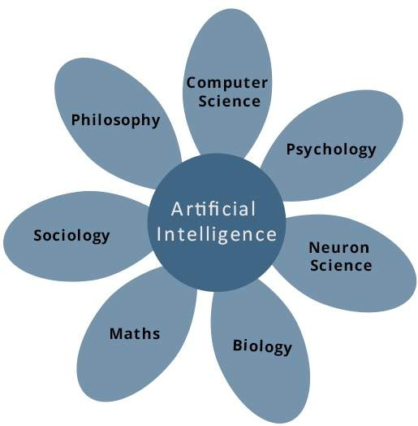

Slide 39
What is AI Technique?
In the real world, the knowledge has some unwelcomed properties −
Its volume is huge, next to unimaginable.
It is not well-organized or well-formatted.
It keeps changing constantly.
AI Technique is a manner to organize and use the knowledge efficiently in such a way that −
It should be perceivable by the people who provide it.
It should be easily modifiable to correct errors.
It should be useful in many situations though it is incomplete or inaccurate.
AI techniques elevate the speed of execution of the complex program it is equipped with.

Slide 40
Applications of AI
Gaming − AI plays crucial role in strategic games such as chess, poker, tic-tac-toe, etc., where machine can think of large number of possible positions based on heuristic knowledge.
Natural Language Processing − It is possible to interact with the computer that understands natural language spoken by humans.
Expert Systems − There are some applications which integrate machine, software, and special information to impart reasoning and advising. They provide explanation and advice to the users.
Vision Systems − These systems understand, interpret, and comprehend visual input on the computer.
Speech Recognition − Some intelligent systems are capable of hearing and comprehending the language in terms of sentences and their meanings while a human talks to it. It can handle different accents, slang words, noise in the background, change in human’s noise due to cold, etc.
Handwriting Recognition − The handwriting recognition software reads the text written on paper by a pen or on screen by a stylus. It can recognize the shapes of the letters and convert it into editable text.
Intelligent Robots − Robots are able to perform the tasks given by a human. They have sensors to detect physical data from the real world such as light, heat, temperature, movement, sound, bump, and pressure.

Slide 41
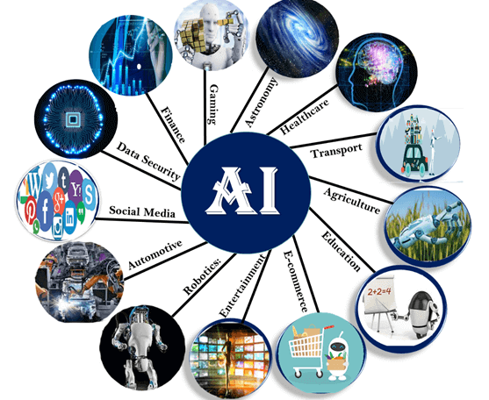

Slide 42
Advantages of Artificial Intelligence
Following are some main advantages of Artificial Intelligence:
High Accuracy with less errors: AI machines or systems are prone to less errors and high accuracy as it takes decisions as per pre-experience or information.
High-Speed: AI systems can be of very high-speed and fast-decision making, because of that AI systems can beat a chess champion in the Chess game.
High reliability: AI machines are highly reliable and can perform the same action multiple times with high accuracy.
Useful for risky areas: AI machines can be helpful in situations such as defusing a bomb, exploring the ocean floor, where to employ a human can be risky.
Digital Assistant: AI can be very useful to provide digital assistant to the users such as AI technology is currently used by various E-commerce websites to show the products as per customer requirement.
Useful as a public utility: AI can be very useful for public utilities such as a self-driving car which can make our journey safer and hassle-free, facial recognition for security purpose, Natural language processing to communicate with the human in human-language, etc.

Slide 43
Disadvantages of Artificial Intelligence
High Cost: The hardware and software requirement of AI is very costly as it requires lots of maintenance to meet current world requirements.
Can't think out of the box: Even we are making smarter machines with AI, but still they cannot work out of the box, as the robot will only do that work for which they are trained, or programmed.
No feelings and emotions: AI machines can be an outstanding performer, but still it does not have the feeling so it cannot make any kind of emotional attachment with human, and may sometime be harmful for users if the proper care is not taken.
Increase dependency on machines: With the increment of technology, people are getting more dependent on devices and hence they are losing their mental capabilities.
No Original Creativity: As humans are so creative and can imagine some new ideas but still AI machines cannot beat this power of human intelligence and cannot be creative and imaginative.

Slide 44
What is Deep Learning
Deep learning can be considered as a subset of machine learning.
It is a field that is based on learning and improving on its own by examining computer algorithms.
While machine learning uses simpler concepts, deep learning works with artificial neural networks, which are designed to imitate how humans think and learn.
Until recently, neural networks were limited by computing power and thus were limited in complexity.
However, advancements in Big Data analytics have permitted larger, sophisticated neural networks, allowing computers to observe, learn, and react to complex situations faster than humans.
Deep learning has aided image classification, language translation, speech recognition.
It can be used to solve any pattern recognition problem and without human intervention.

Slide 45
Artificial neural networks, comprising many layers, drive deep learning.
Deep Neural Networks (DNNs) are such types of networks where each layer can perform complex operations such as representation and abstraction that make sense of images, sound, and text.
Considered the fastest-growing field in machine learning, deep learning represents a truly disruptive digital technology, and it is being used by increasingly more companies to create new business models.

Slide 46
How Does Deep Learning Work?
Neural networks are layers of nodes, much like the human brain is made up of neurons.
Nodes within individual layers are connected to adjacent layers.
The network is said to be deeper based on the number of layers it has.
A single neuron in the human brain receives thousands of signals from other neurons.
In an artificial neural network, signals travel between nodes and assign corresponding weights.
A heavier weighted node will exert more effect on the next layer of nodes. The final layer compiles the weighted inputs to produce an output.
Deep learning systems require powerful hardware because they have a large amount of data being processed and involves several complex mathematical calculations.
Even with such advanced hardware, however, deep learning training computations can take weeks.

Slide 47
Image Classification with Convolutional Neural Networks
Convolutional neural networks (CNN) – the concept behind recent breakthroughs and developments in deep learning.
CNNs have broken the mold and ascended the throne to become the state-of-the-art computer vision technique.
Among the different types of neural networks (others include recurrent neural networks (RNN), long short term memory (LSTM), artificial neural networks (ANN), etc.), CNNs are easily the most popular.
These convolutional neural network models are ubiquitous in the image data space.
They work phenomenally well on computer vision tasks like image classification, object detection, image recognition, etc.

Slide 48
Convolutional neural networks (CNN) – the concept behind recent breakthroughs and developments in deep learning.
CNNs have broken the mold and ascended the throne to become the state-of-the-art computer vision technique. Among the different types of neural networks (others include recurrent neural networks (RNN), long short term memory (LSTM), artificial neural networks (ANN), etc.), CNNs are easily the most popular.
These convolutional neural network models are ubiquitous in the image data space. They work phenomenally well on computer vision tasks like image classification, object detection, image recognition, etc.
So – where can you practice your CNN skills? Well, you’ve come to the right place!
There are various datasets that you can leverage for applying convolutional neural networks. Here are three popular datasets:
MNIST
CIFAR-10
ImageNet

Slide 49
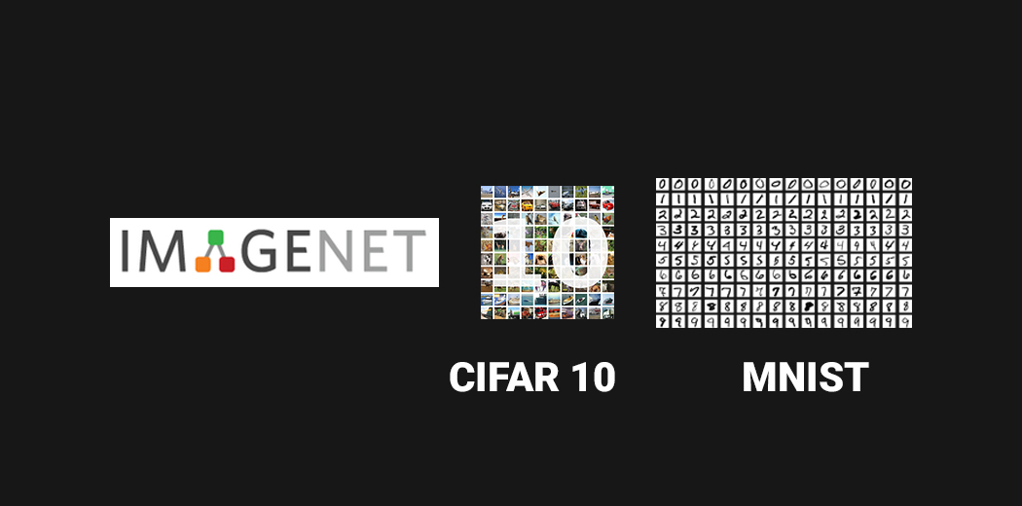

Slide 50


